Slide 1



Source: gfycat.com (Animaniacs)
Become
with
gganimate
Peter Kamerman
@painblogR
www.painblogr.org
Joburg 2019

Slide 2
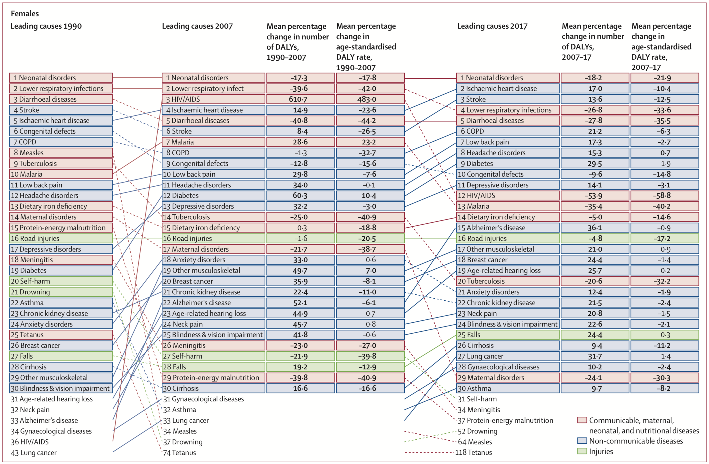
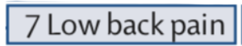
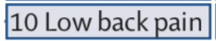
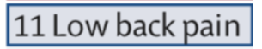
The template
GBD 2017 DALYs and HALE Collaborators. Lancet 392:1859–1922, 2018. doi: 10.1016/S0140-6736(18)32335-3

Slide 3
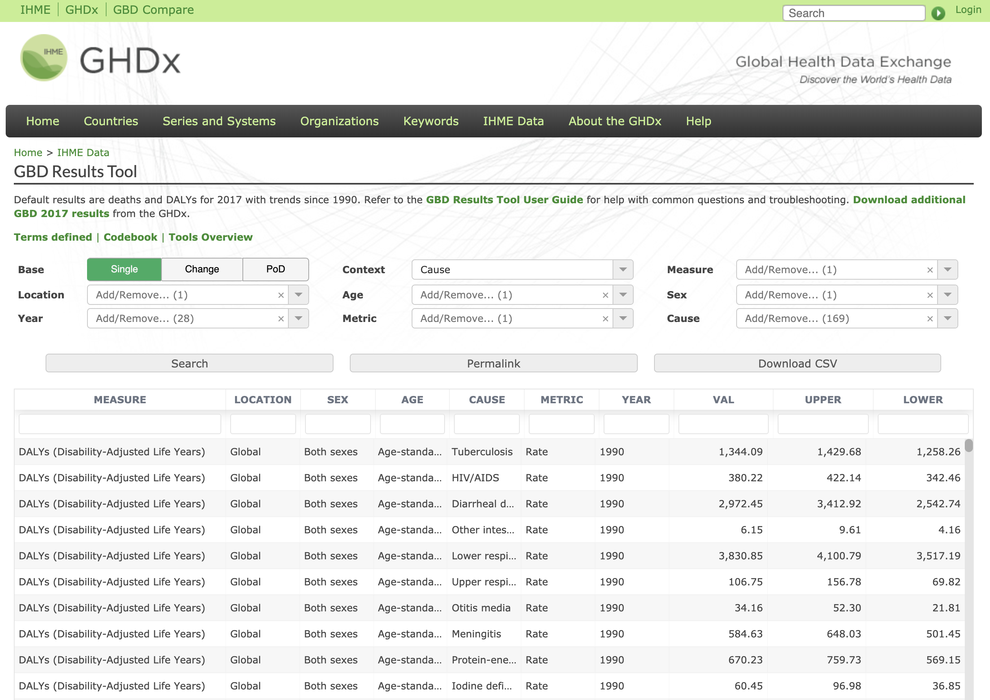
The data source
Source: http://ghdx.healthdata.org/gbd-results-tool

Slide 4
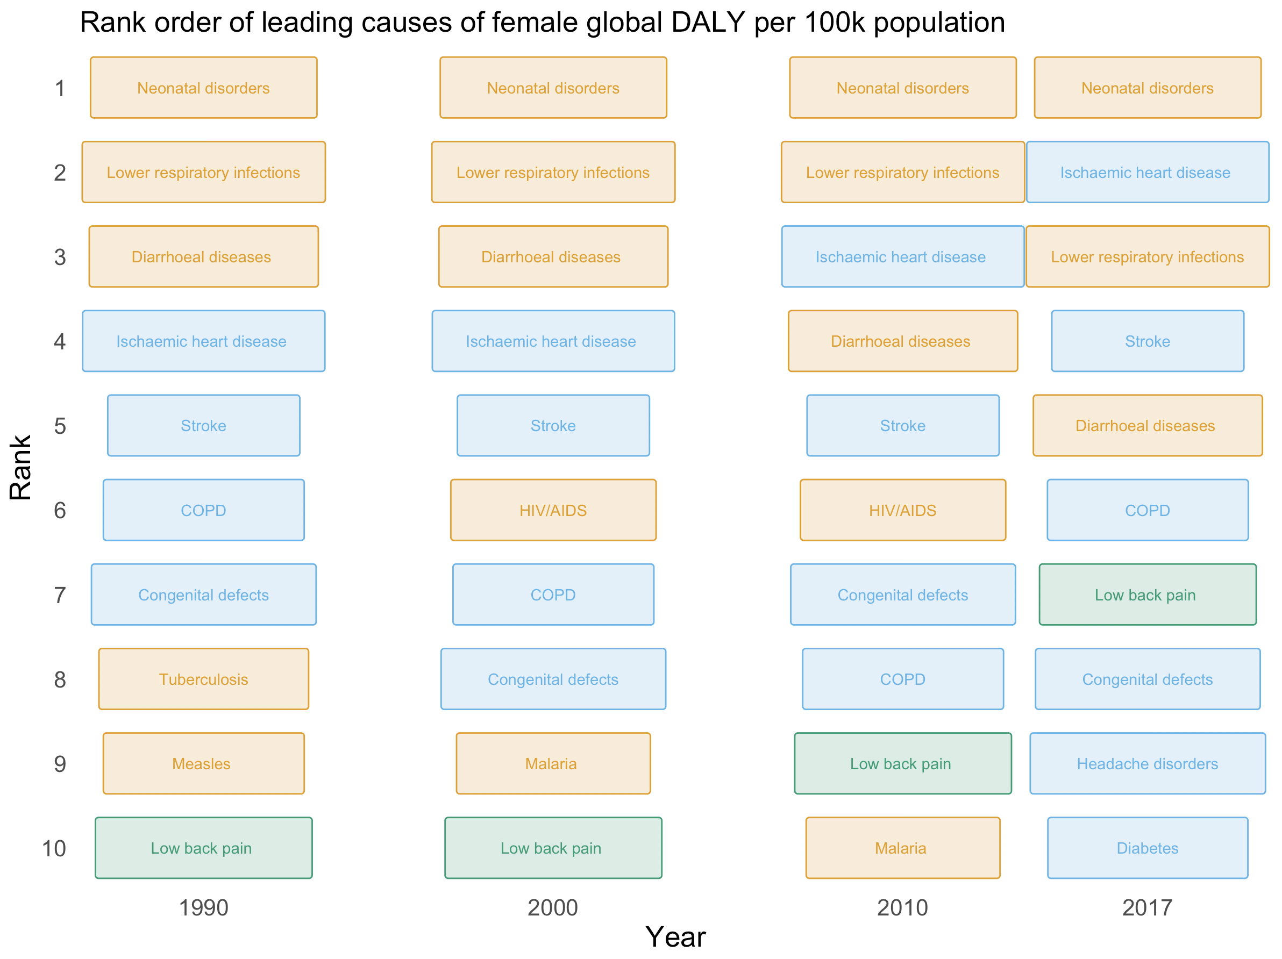
What I got
1
2
3
4
5
Rank
6
7
8
9
10
1990
2000
2007
2017
Year
Source: GBD 2017 DALYs and HALE Collaborators. Lancet 392:1859–1922, 2018. doi: 10.1016/S0140-6736(18)32335-3

Slide 5
…was boring
Source: picgifs.com (Fight Club)

Slide 6
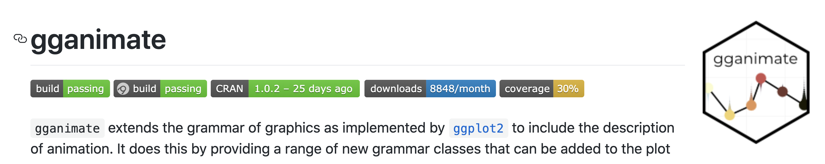
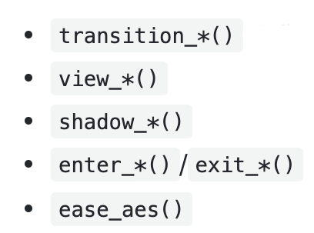


Adding some action
Source: https://github.com/thomasp85/gganimate
Notes:
transition_*() defines how the data should be spread out and how it relates to itself across time.
view_*() defines how the positional scales should change along the animation.
shadow_*() defines how data from other points in time should be presented in the given point in time.
enter_*()/exit_*() defines how new data should appear and how old data should disappear during the course of the animation.
ease_aes() defines how different aesthetics should be eased during transitions.

Slide 7
transition_reveal
90
Temperature (ºF)
80
70
60
0
10
20
30
Day
Source: https://github.com/thomasp85/gganimate/wiki/Temperature-time-series

Slide 8
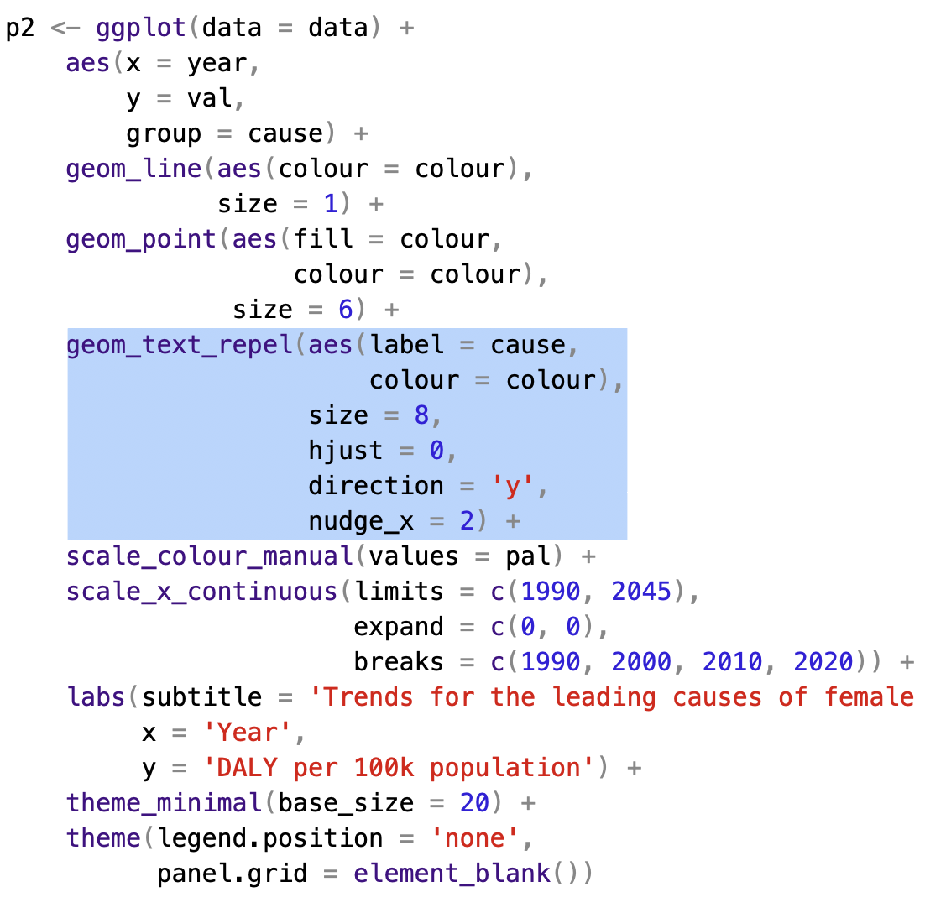
transition_reveal + ggrepel
p1
Line plot
+ points
Repelling labels

Slide 9

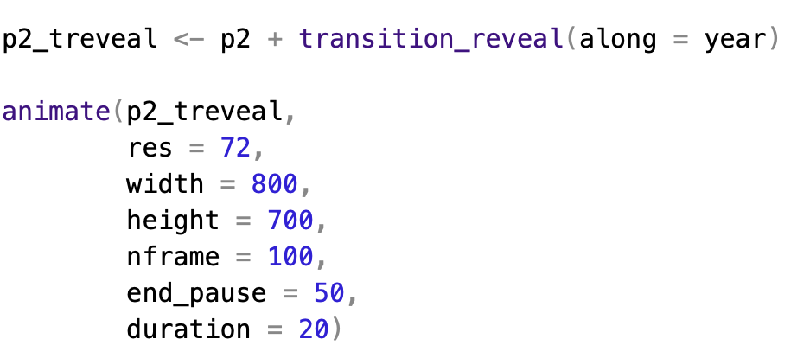
transition_reveal + ggrepel
p1
P1_reveal
p1
P1_reveal

Slide 10
transition_reveal + ggrepel
4000
3000
DALY per 100k population
2000
1000
1990
2000
2010
2020
Year

Slide 11

Scripts and data to reproduce animated plots
kamermanpr/satRday2019

